Slide 1
BITS Pilani presentation
Yogesh B
Introduction to DevOps

Slide 2
CSIZG514/SEZG514, Introduction to DevOps
Lecture No. 2 and 3

Slide 3
Agenda
DevOps Misconceptions and Dimensions
DevOps Misconceptions
DevOps Antipatterns
Three Dimensions of DevOps

Slide 4
DevOps Misconceptions
DevOps Only Involves Developers and System Administrators
As the name indicates Development and Operations
However the Truth is:
DevOps tagline is bring development and operations together
The concepts and ideas of DevOps include all roles within an organization
There is no definitive list of which teams or individuals should be involved
Any team within the organization should be considered as a candidate for DevOps, it may include security, QA, support, and legal

Slide 5
DevOps Misconceptions Contd..
DevOps is a Team
Creating a team called DevOps, OR
Renaming an existing team to DevOps is neither necessary nor sufficient for creating a DevOps culture
However truth is:
An additional team is likely to cause more communication issues, not fewer
the development and operations teams must connect frequently or it should work together
In a startup environment, having a single team that encompasses both functions can work

Slide 6
DevOps Misconceptions Contd..
DevOps is a Job Title
The “DevOps engineer” job title has started a controversial debate
The job title has been described in various ways
A system administrator who also knows how to write code
A developer who knows the basics of system administration
However truth is:
In DevOps it makes sense to have people become more specialized in their job role
DevOps is at its core a cultural movement, and its ideas and principles need to be used throughout entire organizations in order to be effective

Slide 7
DevOps Misconceptions Contd..
You Need a DevOps Certification
Certification exams are testing knowledge where there are clear right or wrong answers, which DevOps generally does not have
However truth is:
A significant part of DevOps is about culture: how do you certify culture?
DevOps doesn’t have required technology or one-size-fits-all solutions

Slide 8
DevOps Misconceptions Contd..
DevOps Means Doing All the Work with Half the People
Get both a software developer and a system administrator in one person and with one person’s salary
However truth is:
Not only is this above perception incorrect, but it is often harmful
At a time startups are offering perks such as three meals a day in the office and on-site laundry as a way of encouraging
DevOps doesn’t save money by halving the number of engineers your company needs
Rather, it allows organizations to increase the quality and efficiency of their work

Slide 9
DevOps Misconceptions Contd..
DevOps Is About Automation
Many innovations in DevOps-adjacent tools help to codify understanding, bridging the gaps between teams and increasing velocity through automation
Practitioners have focused on tools that eliminate tasks that are boring and repetitive, such as with infrastructure automation and continuous integration
However truth is:
In both of these above cases, automation is a result of improved technology
Automating repetitive tasks automation will help to human from having to do them, that automation helps that person work more efficiently
Example: Automating server builds saves hours per server that a system administrator can then spend on more interesting or challenging work

Slide 10
DevOps Misconceptions Contd..
DevOps Is a FAD
It’s a Buzzword in Market
Just a new word in place
However truth is:
As DevOps is not specific to a technology, tool, or process however, It is movement about improving organizational effectiveness and individual employee happiness
One of the primary differences between DevOps and methodologies like ITIL and Agile is:
It does not have strict definition
DevOps is movement defined by stories and ideas of individuals, teams, and organizations
DevOps is the evolution of processes and ideas that lead growth and change
Harnessing and leveraging effective DevOps will lead to growth and evolution in tools, technology, and processes in your organization

Slide 11
DevOps Anti-Patterns
Blame Culture
  A blame culture is one that tends toward blaming and punishing people when mistakes are made, either at an individual or an organizational level
Silos
  A departmental or organizational silo describes the mentality of teams that do not share their knowledge with other teams in the same company
Root Cause Analysis
  Root cause analysis (RCA) is a method to identify contributing and “root” causes of events or near-misses/close calls and the appropriate actions to prevent recurrence
Human Errors
  Human error, the idea that a human being made a mistake that directly caused a failure, is often cited as the root cause in a root cause analysis

Slide 12
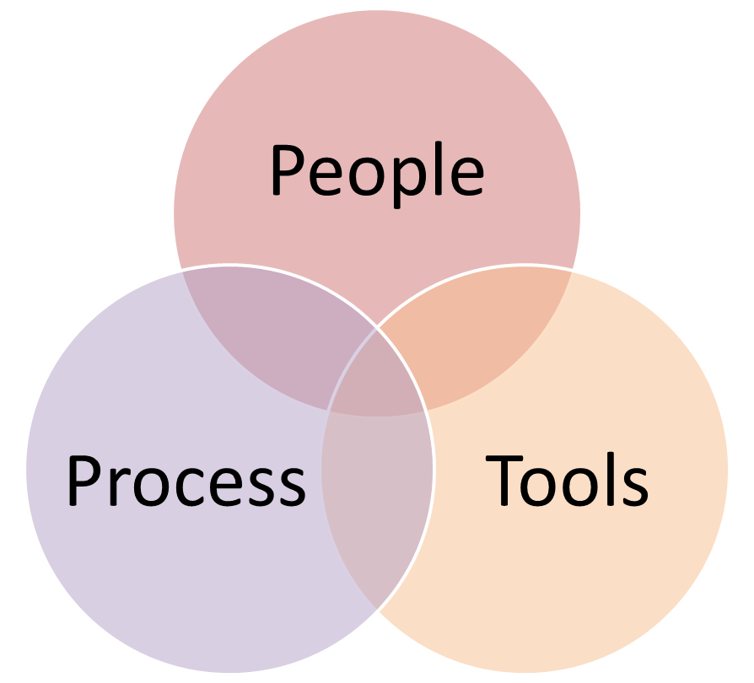
Three dimensions of DevOps
3-D of DevOps
People
Process
Tools / Technology
Collaboration
Innovation
DevOps
Automation

Slide 13
Agenda
Agile Methodology SCRUM
Scrum

Slide 14
SCRUM Methodology
About Scrum
Scrum is part of the Agile movement
Scrum is an agile way to manage a project, usually software development
Scrum’s early advocates were inspired by empirical inspect and adapt feedback loops to cope with complexity and risk
Scrum emphasizes decision making from real-world results rather than speculation
By Mountain Goat Software – Pioneer of Agile
“Agile software development with Scrum is often perceived as a methodology; but rather than viewing Scrum as methodology, think of it as a framework for managing a process”

Slide 15
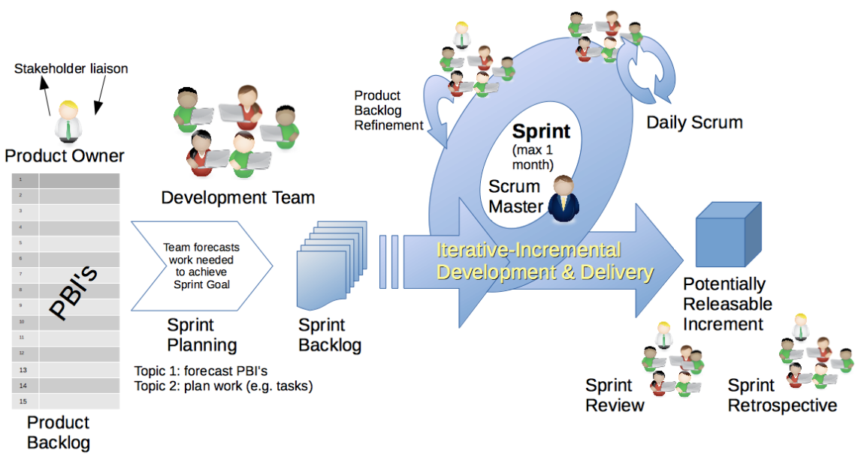
SCRUM
Scrum Sprints

Slide 16
SCRUM
Benefits of Scrum
Flexibility
Quality
Incremental Working Product
Early to Market

Slide 17
Agenda
Agile Methodologies
Test Driven Development
Feature Driven Development
Behavior Driven Development

Slide 18
TDD
TDD Introduction
Kent Beck said “Test-first code tends to be more cohesive and less coupled than code in which testing isn’t a part of the intimate coding cycle”
“If you can’t write a test for what you are about to code, then you shouldn’t even be thinking about coding”

Slide 19
TDD
TDD Three steps
RED
  Write a new TEST which fails
GREEN
  Write simplest possible code to make it succeed
REFACTOR
  Refactor the code (including test code)

Slide 20
TDD
TDD Technique
TDD is a technique whereby you write your test cases before you write any implementation code

Slide 21
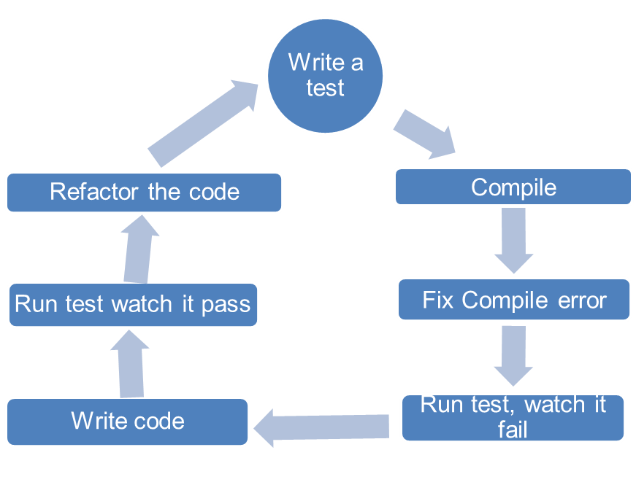
TDD
TDD Overview

Slide 22
TDD
TDD Overview Contd..
How It Works:
Add a Test
  Use Cases / User Stories are used to understand the requirement clearly
Run all tests and see the new one fail
  Ensures test harness is working correctly
  Ensures that test does not mistakenly pass
Write some code
  Only code that is designed to pass the test
  No additional functionality should be included because it will be untested
Run the automated tests and see them succeed
  If tests pass, programmer can be confident code meets all tested requirements
Refactor code
  Cleanup the code
  Rerun tests to ensure cleanup did not break anything
Repeat

Slide 23
TDD
TDD Overview Contd..
In Extreme Programming Explored (The Green Book), Bill Wake describes the test / code cycle:
  Write a single test
  Compile it. It shouldn’t compile because you’ve not written the implementation code
  Implement just enough code to get the test to compile
  Run the test and see it fail
  Implement just enough code to get the test to pass
  Run the test and see it pass
  Refactor for clarity and “once and only once”
  Repeat

Slide 24
TDD
Why TDD
TDD can lead to more modularized, flexible, and extensible code
Clean code
Leads to better design
Better code documentation
More productive

Slide 25
TDD
Test First vs. Test Last
User Story
User Story
Understand
Understand
Add a test case
Implementation
Write code
Write the tests for story
Run all tests
Run all tests
Rework
Rework
Result?
P
Result?
P
F
Story completed?
F
No
Next story
Yes
Next story

Slide 26
Feature Driven Development
FDD History
Original Creator: Jeff De Luca
  Singapore in late 1997
FDD evolved from an actual project
  Bank Loan Automation
  Luca was Project manager
  50 member developer team
  Peter Coad : Chief Architect
    1990’s object-oriented analysis and design expert

Slide 27
FDD
What is a Feature?
Definition: small function expressed in client-valued terms
FDD’s form of a customer requirement

Slide 28
FDD
FDD Primary Roles
Project Manager
Chief Architect
Development Manager
Domain Experts
Class Owners
  This concept differs FDD over XP
  Benefits
    Someone responsible for integrity of each class
    Each class will have an expert available
    Class owners can make changes much quicker, if needed anytime
    Easily lends to notion of code ownership
    Assists in FDD scaling to larger teams, as we have one person available for complete ownership of feature.
Chief Programmers

Slide 29
FDD
FDD Supporting Roles
Release Manager
Language Guru
Build Engineer
Toolsmith
System Administrator
Tester
Deployers
Technical Writer

Slide 30
FDD
Feature Driven Development Process
Process #1: Develop an Overall Model
Process #2: Build a Features List
Process #3: Plan By Feature
  Constructing the initial schedule, Forming level of individual features, Prioritizing by business value , As we work on above factors we do consider dependencies, difficulty, and risks.
  These factors will help us on Assigning responsibilities to team members, Determining Class Owners , Assigning feature sets to chief programmers
Process #4: Design By Feature
  Goal: not to design the system in its entirety but instead is to do just enough initial design that you are able to build on
  This is more about Form Feature Teams: Where team members collaborate on the full low level analysis and design.
Process #5: Build By Feature
  Goal: Deliver real, completed, client-valued function as often as possible

Slide 31
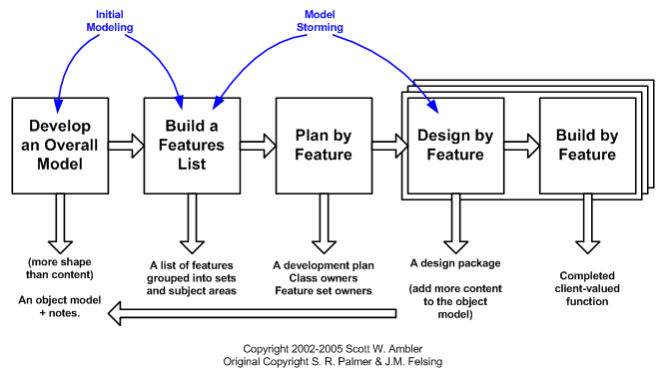
FDD
Feature Driven Development Process Contd..

Slide 32
Behavior Driven Development
BDD Introduction
Behavior-Driven Development (BDD) is a software development process
BDD is considered an effective technical practice especially when the "problem space" for the business is complex
What is BDD?:
  General Technique of TDD
  Follows same principle as TDD
  Shared tools
  Shared Process

Slide 33
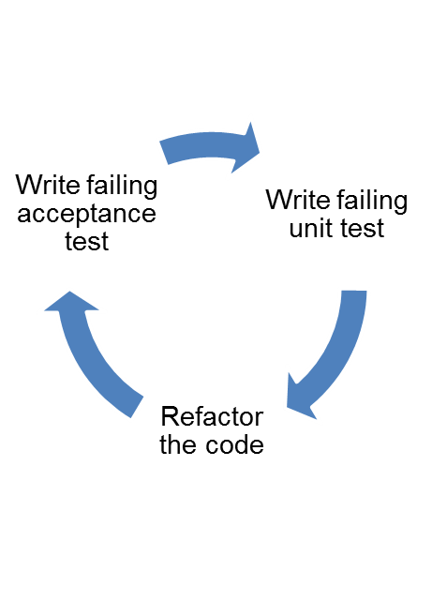
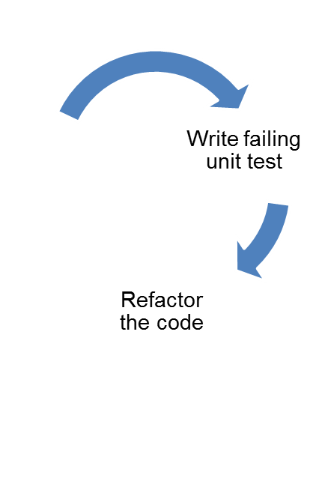
BDD
BDD Focus
Where to start in the process
What to test and what not to test
How much to test in one go
What to call the tests
How to understand why a test fails
BDD
TDD

Slide 34
BDD
BDD Basic structure
BDD consists of cycles of a set of steps to follow.
  Identify business feature
  Identify scenarios under the selected feature
  Define steps for each scenario
  Run feature and fail
  Write code to make steps pass
  Refactor code, Create reusable automation library
  Run feature and pass
  Generate test reports

Slide 35
BDD
BDD Example
User story:
As someone interested in using the Mobile app, and want to sign up in app to enjoy app membership
Mobile App Signup:
Scenario 1:
  Given that I am on the app's "Create new account" screen
  Then I should see a "Sign up using Facebook" button
  And I should see a "Sign up using Twitter" button
  And I should see a "Sign up with email" form field
Then I should see a new screen that asks permission to use my Facebook account data to create my new Mobile app account

Slide 36
BDD
BDD Sign Use
Functional Documentation in terms of User Stories & Executable Scenarios
Instead of referring to "tests", a BDD practitioner will prefer the terms "scenario" and "specification"
Rather than refer to "functional tests", the preferred term will be "specifications of the product's behavior"
Specification Names are more expressive

Slide 37
References
http://agilemodeling.com/

Slide 38
Agenda
DevOps – People
DevOps Team Structure
Team Coordination

Slide 39
Team Structure
Team Size
The size of the team should be relatively small
Amazon has a “two pizza rule”
That is, no team should be larger than can be fed from two pizzas
The advantages of small teams are
  They can make decisions quickly
  It is easier for individuals to express an opinion
  It is easier for individuals to express an idea in front of a small group than in front of a large one
The disadvantage
  Some tasks are larger than can be accomplished by a small number of individuals
  Task has to be broken up into smaller pieces
  A small team, by necessity, works on a small amount of code

Slide 40
Team Structure
Team Roles
We will study roles in the team from Scott Ambler’s description of roles in an agile team
Team lead :
  This role you can relate to “Scrum Master” of SCRUM TEAM.
  Also you can relate to Project Lead
  Is responsible:
    For facilitating the team
    Obtaining resources for it
    And protecting it from problems
  This role encompasses the soft skills of project management but not the technical ones such as planning and scheduling, activities which are better left to the team as a whole.
Team member
  This role, sometimes referred to as developer or programmer
  Is responsible for the creation and delivery of a system
  This includes modeling, programming, testing, and release activities, as well as others

Slide 41
Team Structure
Additional roles
Service owner
Reliability engineer
Gatekeeper
And DevOps engineer

Slide 42
Team Structure
Service Owner
This role on the team responsible for outside coordination
The service owner participates:
  System-wide requirements activities
  Prioritizes work items for the team
  And provides information both from the clients of the team’s service and about services provided to the team.
  The requirements gathering and release planning activities for the next iteration can occur in parallel with the conception phase of the current iteration
  The service owner maintains and communicates the vision for the service
  That is, the vision involves the architecture of the overall system and the team’s role in that architecture

Slide 43
Team Structure
Reliability Engineer
Reliability engineer monitors the service in the time period immediately subsequent to the deployment
Second, the reliability engineer is the point of contact for problems with the service during its execution
Google calls this role “Site Reliability Engineer.”
Once a problem occurs, the reliability engineer performs short-term analysis to diagnose, mitigate, and repair the problem
In any case, the reliability engineer has to be excellent at troubleshooting and diagnosis
The reliability engineer should discover or work with the team to discover the root cause of a problem
Increasingly, reliability engineers need to be competent developers, as they need to write high-quality programs to automate the repetitive part of the diagnosis, mitigation, and repair

Slide 44
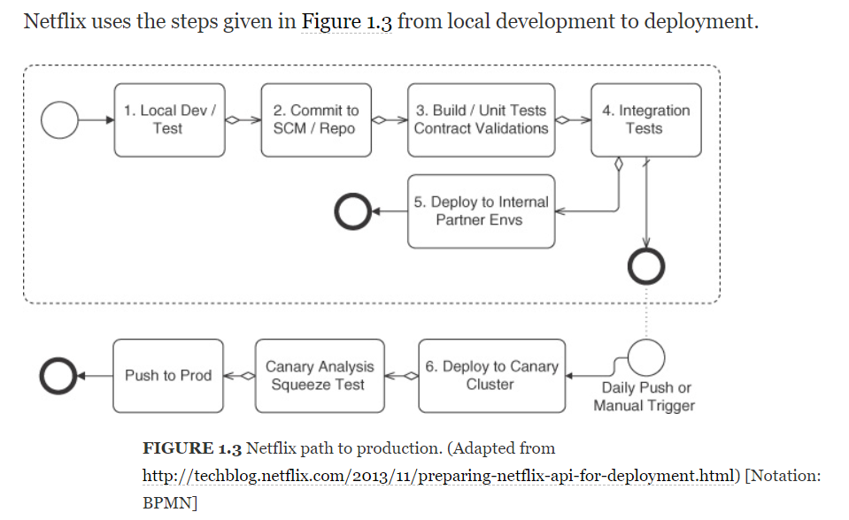
Team Structure
Gatekeeper

Slide 45
Team Structure
DevOps Engineer
The DevOps engineer role is responsible for the care and feeding of the various tools used in the DevOps tool chain
The DevOps engineer’s role, as are the tailoring of the tool for the development team and monitoring
The DevOps engineering role is inherent in automating the development and deployment pipeline
DevOps engineer also deals with configuration managements tools which are like Puppet, Ansible and Chef etc.
These configuration management solutions are applied to the source code for the service

Slide 46
Team Coordination
Forms of Coordination
One goal of DevOps is to minimize coordination in order to reduce the time to market
Two of the reasons to coordinate are, first, so that the pieces developed by the various teams will work together and, second, to avoid duplication of effort
Forms of Coordination
  Direct—the individuals coordinating know each other (e.g., team members)
  Indirect—the coordination mechanism is aimed at an audience known only by its characterization (e.g. Operators)
  Persistent—the coordination artifacts are available after the moment of the coordination (e.g., documents, e-mail, bulletin boards)
  Ephemeral—the coordination, per se, produces no artifacts (e.g., face to face meetings, conversations, telephone/video conferencing)
  Synchronous—individuals are coordinating in real time, (e.g., face to face)
  Asynchronous—individuals are not coordinating in real time (e.g., documents, e-mail)

Slide 47
Team Coordination
Team coordination mechanisms
Team coordination mechanisms are of two types
  Human Processes and
  Automated Processes
The DevOps human processes are adopted from agile processes and are designed for high-bandwidth coordination with limited persistence
  Examples: Stand-up meetings
Automated team coordination mechanisms are designed to protect team members from interference of their and others’ activities:
  To automate repetitive tasks (continuous integration and deployment),
  And to speed up error detection and reporting (automated unit, integration, acceptance, and live production tests)

Slide 48
Team Coordination
Cross-team Coordination
Coordination must occur with customers, stakeholders, other development teams, and operations. Therefore, DevOps processes attempt to minimize this coordination as much as possible
There are three types of cross-team coordination:
  Upstream Coordination [with stakeholders and customers]
  Downstream Coordination [with operations]
  And Cross-Stream Coordination [with other development teams]
There are two reasons for a development team to coordinate with other development teams
  To ensure that the code developed by one team works well with the code developed by another
  And to avoid duplication of effort

Slide 49
Agenda
DevOps People
Transformation to Enterprise DevOps culture

Slide 50
Transformation to Enterprise DevOps culture
Constraints of Large Enterprise :: DevOps Transformation
Organization Structure
Legacy Technology Stack
Organization Culture

Slide 51
Transformation to Enterprise DevOps culture
Concepts
Executives do not like terms such as “Transformation”
Somehow it is often interpreted as:
  Cost Cutting or
  Resource Realignment or
  Outsourcing
Why organizations are pushing to be DevOps
The intent is to transform the way solutions are being delivered today and to do it faster, cheaper and better
The techniques of Agile and DevOps have been successfully implemented in many large and small organizations to enable those outcomes
Look in to the approach that worked quite well for most enterprises

Slide 52
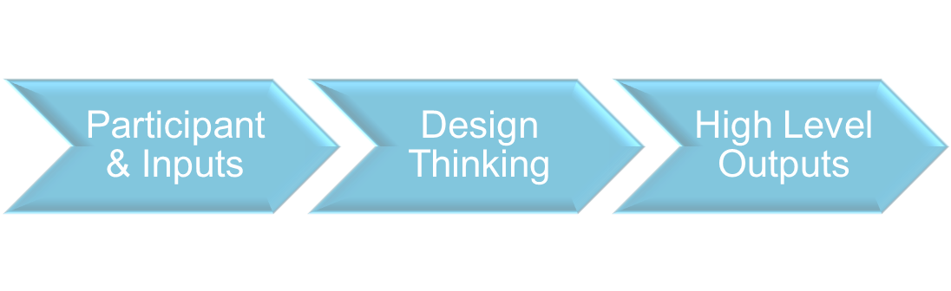
Transformation to Enterprise DevOps culture
Initial Planning for Enterprise Readiness
Participants should absolutely include all the towers that make up the solution delivery
Design Thinking : It is a great method; it leverages the expertise of all stakeholders, enables them to come to a common understanding
High Level Output

Slide 53
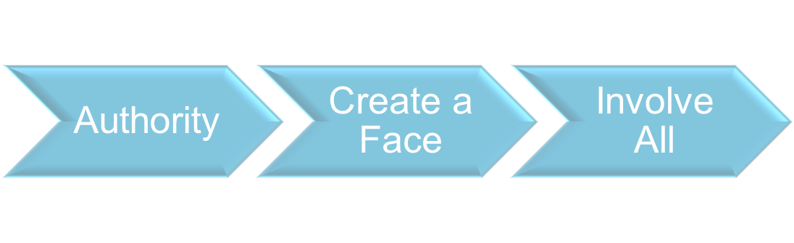
Transformation to Enterprise DevOps culture
Establish a DevOps Center of Excellence
At the right organizational level and enterprise authority
Create a Face: It has to be led by an enterprise leader who has the support and buy-in from all the towers
Active Participant from All Towers of Delivery & Participants must be chosen wisely
These phases help concrete the vision and strategies of organization and help in setup the best practices to support cultural movement

Slide 54
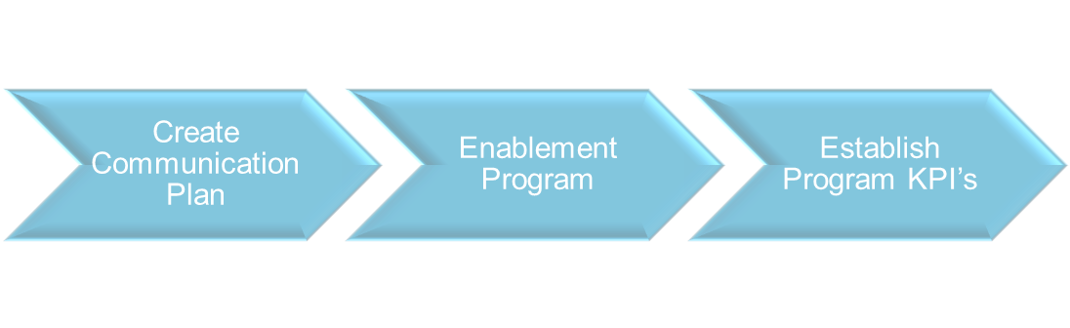
Transformation to Enterprise DevOps culture
Establish Program Governance
Agile and DevOps, practitioners’ roles and responsibilities will change
Need awareness, enablement and empowerment to succeed
KPIs must shift from individual metrics to holistic customer business outcomes

Slide 55

Transformation to Enterprise DevOps culture
Establish Project In-take Process
DevOps SME’s conduct in-take workshops for Scrum Teams
Automation scripts, Infrastructure assets
Test Automation, Branching and Merging & Lessons Learned
Fit for purpose tool selection and Application Criticality

Slide 56
Transformation to Enterprise DevOps culture
Identify and Initiate Pilots
Value stream-mapping exercise
Level of detail necessary:
  To identify end to end as-is process, tooling, manual and automated processes
  And skills and people

Slide 57
Transformation to Enterprise DevOps culture
Scale Out DevOps Program
Onboard Parallel Release Trains
Apply Intake Process
Support, Monitor and Manage

Slide 58
References
I would like to thank you Mr. Sunil Joshi
https://devops.com/six-step-approach-enterprise-devops-transformation/

Slide 59
Thank You!
In our next session:

Slide 60
Pros of Waterfall
Cons of Waterfall

Slide 61
Agile
individuals and interactions over processes and tools
working software over comprehensive documentation
customer collaboration over contract negotiation
responding to change over following a plan

Slide 62
Scrum
Scrum
In the mid-1990s, Ken Schwaber and Dr. Jeff Sutherland, two of the original creators of the Agile Manifesto, merged individual efforts to present a new software development process called Scrum. Scrum is a software development methodology that focuses on maximizing a development team’s ability to quickly respond to changes in both project and customer requirements. It uses predefined development cycles called sprints, usually between one week and one month long, beginning with a sprint planning meeting to define goals and ending with a sprint review and sprint retrospective to discuss progress and any issues that arose during that sprint.

Slide 63
DSM
What did I do yesterday that helped the team meet its sprint goals?
What am I planning to do today to help the team meet those goals?
What, if anything, do I see that is blocking either me or the team from reaching their goals?

Slide 64
Version Control
A version control system records changes to files or sets of files stored within the system. This can be source code, assets, and other documents that may be part of a software development project. Developers make changes in groups called commits or revisions. Each revision, along with metadata such as who made the change and when, is stored within the system in one way or another.
Having the ability to commit, compare, merge, and restore past revisions to objects to the repository allows for richer cooperation and collaboration within and between teams. It minimizes risks by establishing a way to revert objects in production to previous versions.

Slide 65
Test Driven Development
In test-driven development, the code developer starts by writing a failing test for the new code functionality, then writes the code itself, and finally ensures that the test passes when the code is complete. The test is a way of defining the new functionality clearly, making more explicit what the code should be doing.
Having developers write these tests themselves not only greatly shortens feedback loops but also encourages developers to take more responsibility for the quality of the code they are writing. This sharing of responsibility and shorter development cycle time are themes that continue to be important parts of a devops culture.

Slide 66
Continuous Integration
Continuous integration (CI) is the process of integrating new code written by developers with a mainline or “master” branch frequently throughout the day. This is in contrast to having developers working on independent feature branches for weeks or months at a time, merging their code back to the master branch only when it is completely finished. Long periods of time in between merges means that much more has been changed, increasing the likelihood of some of those changes being breaking ones. With bigger changesets, it is much more difficult to isolate and identify what caused something to break. With small, frequently merged changesets, finding the specific change that caused a regression is much easier. The goal is to avoid the kinds of integration problems that come from large, infrequent merges.

Slide 67
Continuos Delivery
Continuous delivery (CD) is a set of general software engineering principles that allow for frequent releases of new software through the use of automated testing and continuous integration. It is closely related to CI, and is often thought of as taking CI one step further, that beyond simply making sure that new changes can be integrated without causing regressions to automated tests, continuous delivery means that these changes can be deployed.

Slide 68
Continuos Deployment
Continuous deployment (also referred to as CD) is the process of deploying changes to production by defining tests and validations to minimize risk. While continuous delivery makes sure that new changes can be deployed, continuous deployment means that they get deployed into production.

Slide 69

Deployment Pipeline
The pattern that is central to this book is the deployment pipeline. A deployment pipeline is, in essence, an automated implementation of your application’s build, deploy, test, and release process. Every organization will have differences in the implementation of their deployment pipelines, depending on their value stream for releasing software, but the principles that govern them do not vary. An example of a deployment pipeline is given in Figure

Slide 70
Antipattern: Deploying Software Manually
The signs of this antipattern are:
• The production of extensive, detailed documentation that describes the steps to be taken and the ways in which the steps may go wrong
• Reliance on manual testing to confirm that the application is running correctly
• Frequent calls to the development team to explain why a deployment is going wrong on a release day
• Frequent corrections to the release process during the course of a release

Slide 71
Antipattern: Deploying to a Production-like Environment Only after Development Is Complete
If testers have been involved in the process up to this point, they have tested the system on development machines.
• Releasing into staging is the first time that operations people interact with the new release. In some organizations, separate operations teams are used to deploy the software into staging and production. In this case, the first time an operations person sees the software is the day it is released into production.
• Either a production-like environment is expensive enough that access to it is strictly controlled, or it is not in place on time, or nobody bothered to create one.
• The development team assembles the correct installers, configuration files, database migrations, and deployment documentation to pass to the people who perform the actual deployment—all of it untested in an environment that looks like production or staging.

Slide 72
Every Change Should Trigger the Feedback Process
Executable code changes when a change is made to the source code. Every time a change is made to the source code, the resulting binary must be built and tested. In order to gain control over this process, building and testing the binary should be automated. The practice of building and testing your application on every check-in is known as continuous integratio

Slide 73
The Feedback Must Be Received as Soon as Possible
They run fast.
• They are as comprehensive as possible—that is to say, they cover more than 75% or so of the codebase, so that when they pass, we have a good level of confidence that the application works.
• If any of them fails, it means our application has a critical fault and should not be released under any circumstances. That means that a test to check the color of a UI element should not be included in this set of tests.
• They are as environment-neutral as possible—that is, the environment does not have to be an exact replica of production, which means it can be simpler and cheaper.
On the other hand, the tests in the later stages have the following general characteristics.

Slide 74
Thank You!
Acknowledgement:
Significant portions of the information in the presentation is from IT Systems Management - Rich Schiesser and other books/Internet. Permission was requested from the publisher, sometime ago for use, but has not been received as yet. This is intended solely to teach BITS students enrolled for IM. I would like to acknowledge and reiterate that all the credit/rights remain with the original authors/publishers only. Mistakes if any are mine.

